Slide 1
Wi-Fi Management and Security
|
|
|
|
|
L2 Network

Slide 2
Module 1
Module 1 will be covering the following topics:
Introduction to Wi-Fi Networks
802.11 Standards Family
Building blocks of Wi-Fi technology (Spectrum Reuse, Carrier Sensing, Modulation, Bandwidth Aggregation, MIMO, Roaming, QoS, VoWiFi)
802.11ax Overview
End-to-End Wi-Fi Network Architecture
Core Network ( AAA, Captive portal, WAG)
Wireless Authentication Models and Mechanisms
Enterprise, Public
WIPS and WIDS

Slide 3
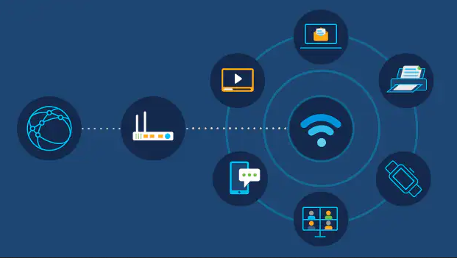
Session 1
Spectrum
Bands
NTA / FCC
802.11

Slide 4
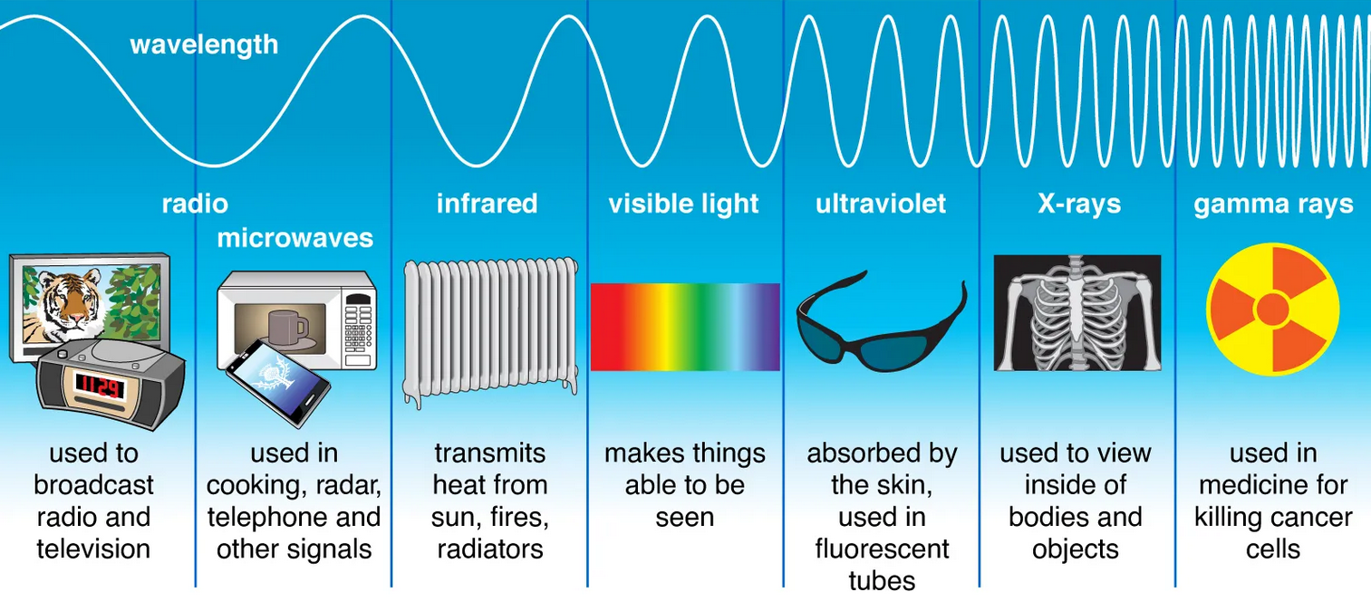
Spectrum

Slide 5
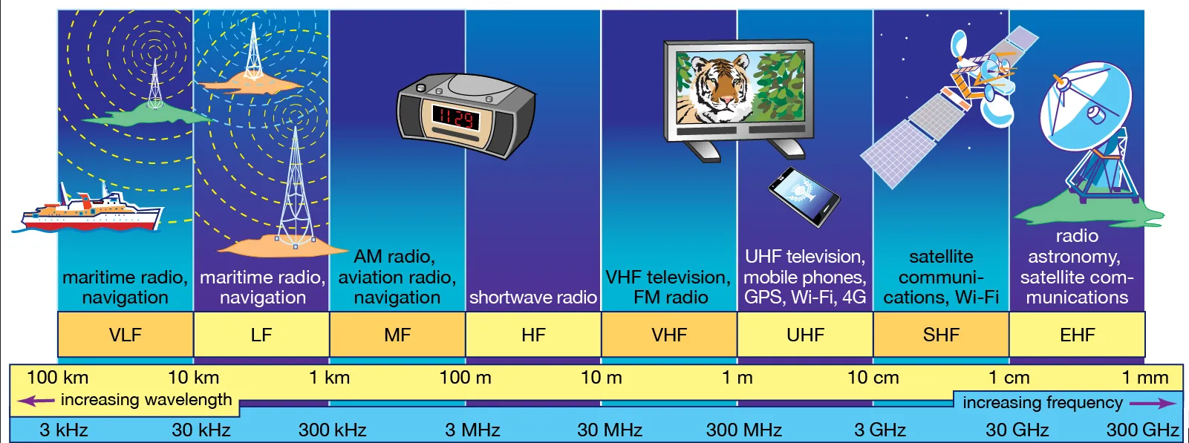
Spectrum

Slide 6
Bands
Band Name | Abbreviation | Frequency and wavelength | Examples
Tremendously low frequency | TLF | <3Hz | 100,000 Km | -
Extremely Low Frequency | ELF | 3–30 Hz | 100,000–10,000 km | Communication and submarines
Super Low Frequency | SLF | 30–300 Hz | 10,000–1,000 km | Communication and submarines
Ultra Low Frequency | ULF | 300–3,000 Hz | 1,000–100 km | Communication with submarines, landline telephony, fax machines
Very Low Frequency | VLF | 3–30 kHz | 100–10 km | Navigation, time signals, communication with submarines, wireless heart rate monitors
Low Frequency | LF | 30–300 kHz | 10–1 km | Navigation, time signals, AM longwave broadcasting
Medium Frequency | MF | 300–3,000 kHz | 1,000–100 m | magnetic resonance imaging, positron emission tomography wireless telegraphy,
High Frequency | HF | 3–30 MHz | 100–10 m | Citizens band radio, aviation communications, marine and mobile radio telephony, magnetic resonance imaging, positron emission tomography.
Very High Frequency | VHF | 30-300 MHz | 10-1 m | FM broadcasts, radars, line-of-sight ground-to-aircraft and aircraft-to-aircraft communications, radioteletype, maritime mobile communications, weather radio, magnetic resonance imaging, positron emission tomography
Ultra High Frequency | UHF | 300–3,000 MHz | 100–10 cm | Cable television broadcasting, radars, microwave devices/communications, radio astronomy, mobile phones, wireless LAN, Bluetooth, ZigBee, GPS satellite radio cordless phones, internet, satellite broadcasting, weather satellites, satellite phones
Super High Frequency | SHP | 3–30 GHz | 10–1 cm | Microwave devices/communications, communications satellites, cable and satellite television broadcasting, satellite broadcasting, communication satellites, weather satellites cordless phones,
Extremely High Frequency | EHF | 30–300 GHz | 10–1 mm | Satellite broadcasting, communication satellites, weather satellites, directed-energy weapon, Wireless Lan 802.11ad.
Terahertz or tremendously high frequency | THF | 300–3,000 GHz | 1–0.1 mm | Experimental medical imaging to replace X-rays

Slide 7
Allocation and Regulation of Radio Spectrum
Nepal Telecommunication Authority
Federal Communications Commission (FCC)
Ofcom
International Telecommunication Union (ITU)

Slide 8
IEEE
IEEE (Institute of Electrical and Electronics Engineers) was formed on January 1, 1963.
Merger of two organizations: the American Institute of Electrical Engineers (AIEE), founded in 1884, and the Institute of Radio Engineers (IRE), founded in 1912.
IEEE (Institute of Electrical and Electronics Engineers) is the world's largest technical professional organization dedicated to advancing technology for the benefit of humanity.

Slide 9
IEEE 802 Standards
IEEE 802 sets of LAN technical standards.
Standard developed and maintained by IEEE 802 LAN/MAN Standards Committee, started on 1979.
Some of the Standards:
IEEE 802.1
IEEE 802.3
IEEE 802.11
IEEE 802.15
IEEE 802.16
IEEE 802.22

Slide 10
Session 2 Introduction to Wi-Fi Networks 802.11
802.11 standards is defined through specification of WLAN
*An over-the-air interface between wireless clients and base station, accepted by IEEE in 1997.

Slide 11
802.11 Standards Family
IEEE 802.11 – 1997
IEEE 802.11b (Wi-Fi 1)
IEEE 802.11a (Wi-Fi 2)
IEEE 802.11g (Wi-Fi 3)
IEEE 802.11e – 2005
IEEE 802.11n (Wireless-N or Wi-Fi 4)
IEEE 802.11ac (Gigabit Wi-Fi or Wi-Fi 5)
IEEE 802.11 ad (WiGig)
IEEE 802.11 ah (Wi-Fi HaLow)
IEEE 802.11ax (Wi-Fi 6)

Slide 12
IEEE 802.11 Standards | Band | Introduced | Speed
IEEE 802.11 1997 | 2.4 GHz | 1997 | 1 Mbps to 2 Mbps
IEEE 802.11a (Wi-Fi 2) | 5 GHz | 1999 (OFDM) | 54 Mbps
IEEE 802.11b (Wi-Fi 1) | 2.4 GHz | 1999 (DSSS) | 11 Mbps
IEEE 802.11g (Wi-Fi 3) | 2.4 GHz | 2003 (Backward Compatibility) | 54 Mbps
IEEE 802.11e 2005 | 2.4 and 5 GHz | 2007 (WMM-QoS) | 54 Mbps
IEEE 802.11n (Wireless-N or Wi-Fi 4) | 2.4 or 5 GHz | 2009 (MIMO) | 600 Mbps
IEEE 802.11ac (Gigabit Wi-Fi or Wi-Fi 5) | 2.4 and 5 GHz | 2013 (Dual Band / MU-MIMO) | 450 Mbps / 1300 Mbps
IEEE 802.11 ad (WiGig) | 60 GHz | 2012 (60 GHZ) | 6.7 Gbps
IEEE 802.11 ah (Wi-Fi HaLow) | 900 MHz | 2017 (900 MHz / Extended Range) | 347 Mbps
IEEE 802.11ax (Wi-Fi 6) and Extended | 2.4 and 5 GHz / 6GHz only (WiFi6E) | 2019 (OFDMA, MU-MIMO, 1024-QAM) | 10 Gbps

Slide 13
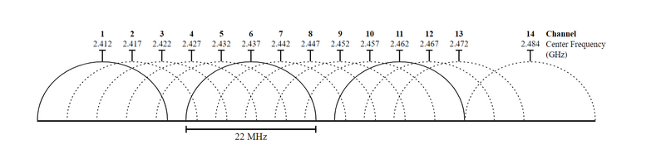
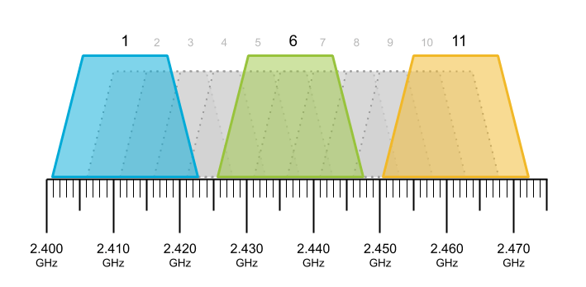
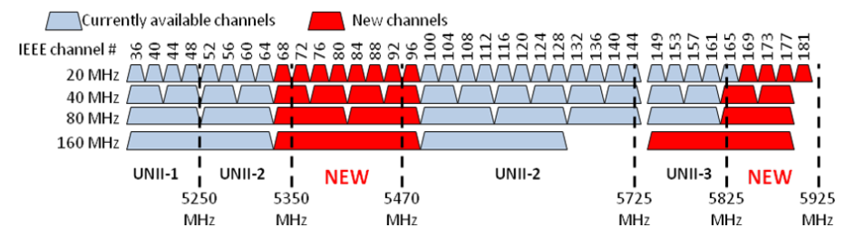

Slide 14
Building blocks of Wi-Fi technology
Spectrum Reuse
Carrier Sensing
Modulation
Bandwidth Aggregation
MIMO
Roaming
QoS
VoWiFi

Slide 15
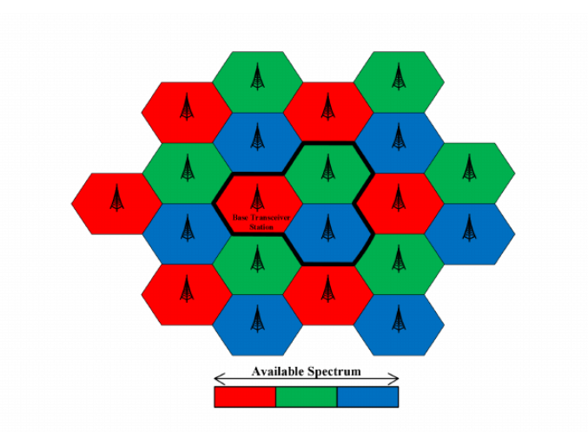
Spectrum Reuse: Selecting and allocating channels groups for all of the stations within a system.

Slide 16
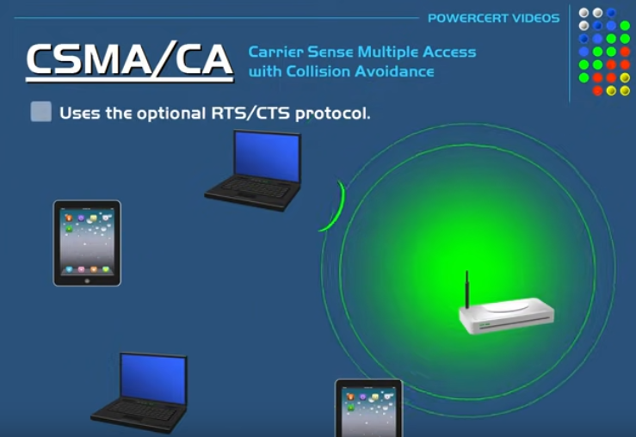
Carrier Sensing: Mechanism used in wireless communication systems
Clear Channel Assessment (CCA): (ED) / (CSMA/CA)

Slide 17
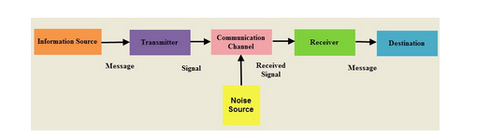
Modulation: Modulation is what wireless networks use to send data.

Slide 18
Bandwidth Aggregation: Spreading communications traffic over more than one channel between two devices to increase total bandwidth.

Slide 19
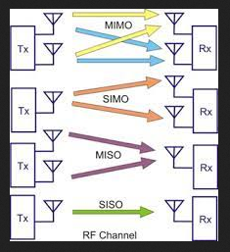
MIMO: Antenna systems used in modern wireless standards, to sends the same data as several signals simultaneously through multiple antennas, while still utilizing a single radio channel.

Slide 20
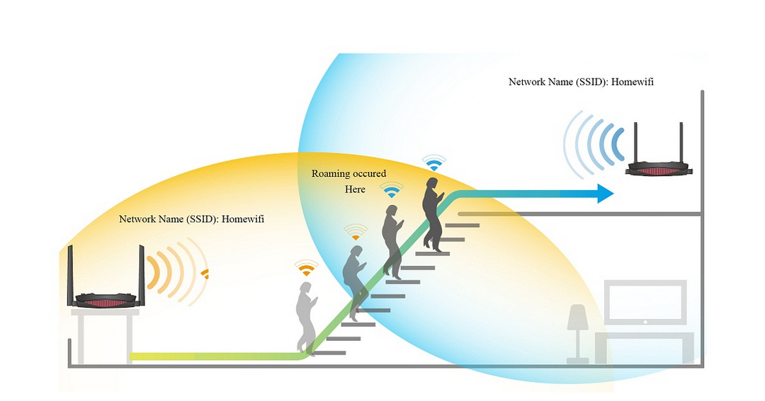
Roaming: Standards designed to make it easier for users to move from one wireless access point to another without losing their connection.

Slide 21
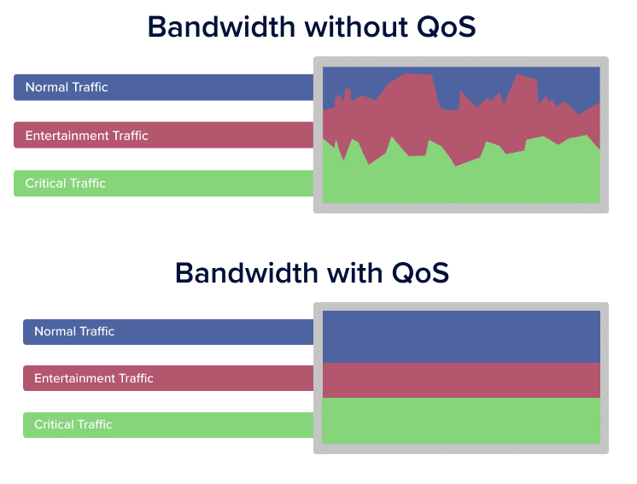
QoS: WMM, which enhances QoS by prioritizing data packets according to different categories.

Slide 22
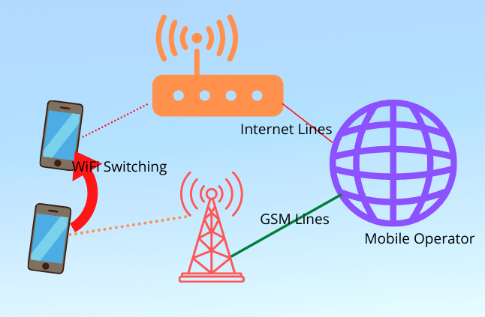
VoWiFi: Process of using Wi-Fi over cellular data, for voice calling for supported device.

Slide 23
802.11ax Overview
Introduced in 2019, as 802.11ax “Wi-Fi”
2.4GHz and 5GHz
Theoretical speed up to 10 Gbps.
Compatible with 802.11a/b/g/n/ac.
Supports Technologies as:
OFDMA, MU-MIMO, 1024-QAM and more
Later introduced Wi-Fi 6E”Extended” in early 2021
2.4GHz / 5GHz and 6GHz
less congested frequency bands.

Slide 24
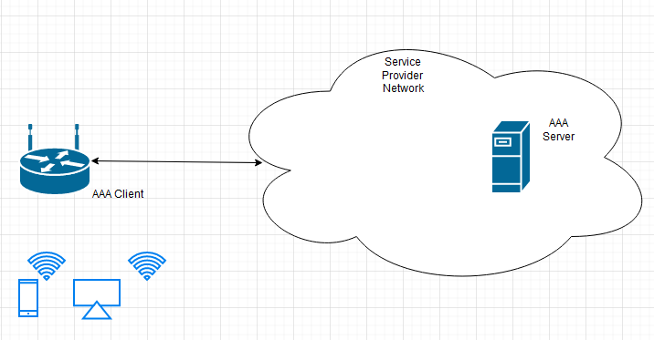
Session 2 End-to-End Wi-Fi Network Architecture
Core Network (AAA, Captive portal, WAG) *Authentication, authorization, and accounting (AAA)

Slide 25
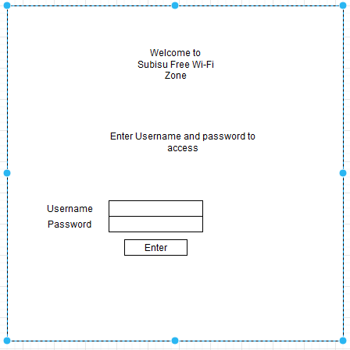
Captive portal
Web page that the user of a public-access network is obliged to view and interact with before access is granted

Slide 26
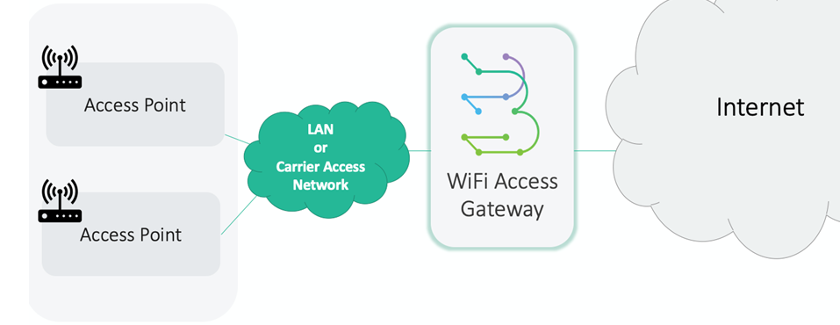
WAG (Wi-Fi Access Gateway)
An element in a network that serves to route data packets from a wireless LAN to another network.
Viewed as a combination of Wi-Fi controller, router, DHCP server, and firewall.

Slide 27
Wireless Authentication Models and Mechanisms
Wireless Authentication: *Open authentication *Shared authentication *Extensible Authentication Protocol (EAP)
Wireless Encryption: *Wired Equivalent Privacy (WEP) *Wi-Fi Protected Access (WPA) *Wi-Fi Protected Access 2 (WPA2)

Slide 28
Wireless Authentication: *Open authentication: Simplest of the method, only require end device to be aware of the SSID ”Service-Set Identifier” *Shared authentication: Commonly used method on individual and small business WLAN Implementation. Using a Shared Key”PSK” at each end. *Extensible Authentication Protocol (EAP) Method used by Enterprises, utilizing authentication server for authentication using variety of credential options.

Slide 29
Wireless Encryption: *Wired Equivalent Privacy (WEP) Utilizes RC4 “Rivest Cipher 4” *Wi-Fi Protected Access (WPA) Utilizes the TKIP“Temporal Key Integrity Protocol” *Wi-Fi Protected Access 2 (WPA2) Utilizes AES “Advanced Encryption Standard”

Slide 30
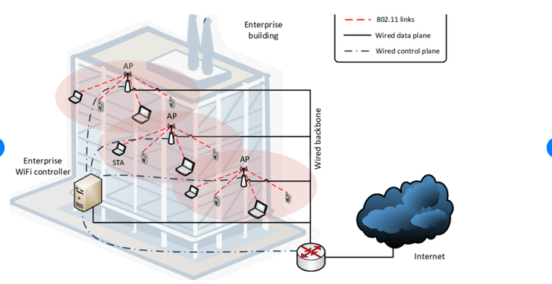
Enterprise

Slide 31
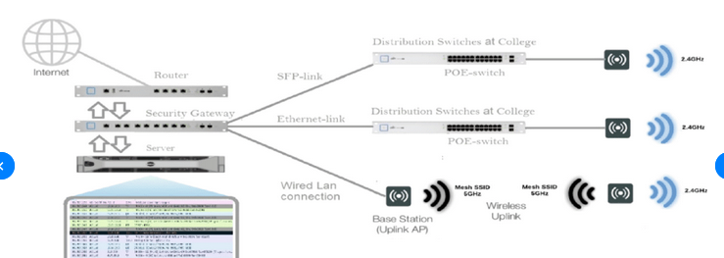
Public

Slide 32
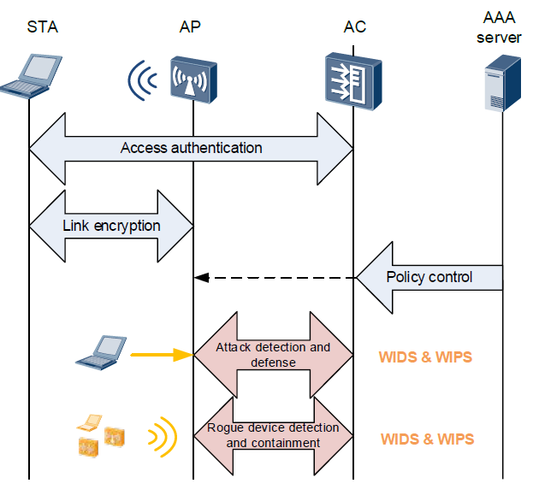
WIPS and WIDS
WIDS, a system of sensors is used to monitor the network for the intrusion of unauthorized devices, such as rogue access points.
WIPS, the system not only detects unauthorized devices, but also takes steps to mitigate the threat by containing the device and detaching it from the wireless network.
Threats *Rogue APSs *Soft Rogue Aps.

Slide 33
END of Module 1
Thank You

